Slide 1
Book Recommendation
Raji Wareez Olalekan
Md Imran Pavel

Slide 2
We used
Pandas python library
Jupyter Notebook (It is nothing necessary. For ease of development)

Slide 3
Data
Source: https://www.kaggle.com/zygmunt/goodbooks-10k/home
Files:
Ratings.csv ( book_id, user_id, ratings )
Books.csv ( book_id, work_id, author, title, average rating etc )
Data also contains, but we don’t need them:
Book_tags.csv ( book_id, tag_id, count )
Tags.csv ( tag_id, tag_name )
To_read.csv ( book_id, user_id )
Contains ratings of 10000 books from 53424 user

Slide 4
Data Filtering
We kept
Books that have at least 100 ratings from users
Users that have rated at least 10 books
Removed Duplicates
Initial Data
10000 Books
53424 Users
Filtered Data
6247 Books
16206 Users

Slide 5
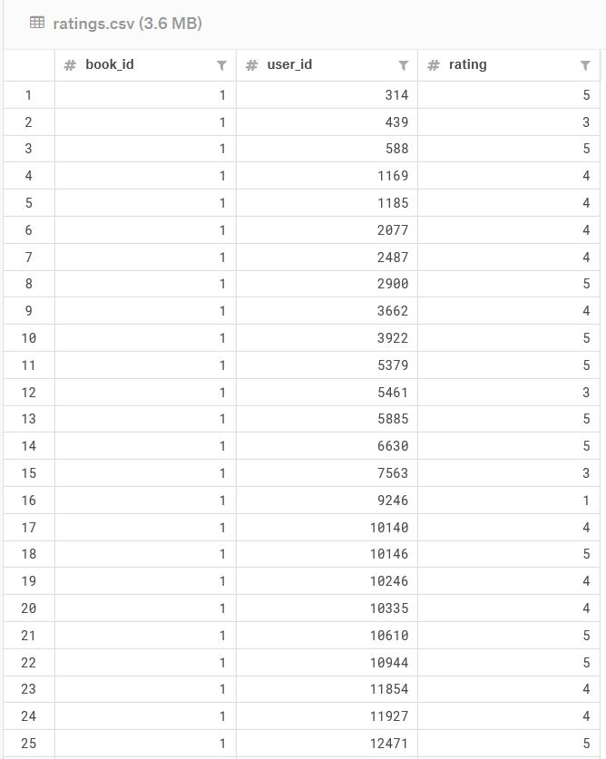
Data (ratings.csv)

Slide 6
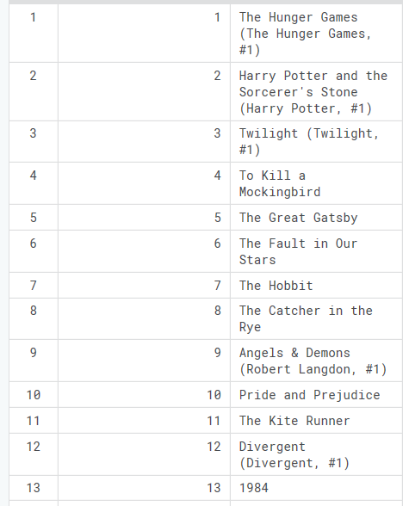
Data (books.csv)

Slide 7
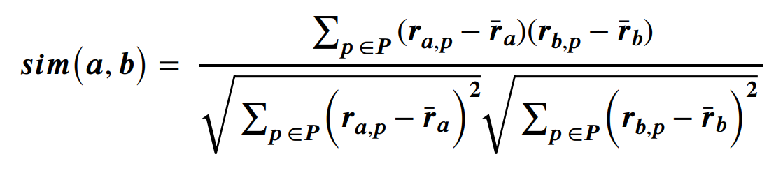
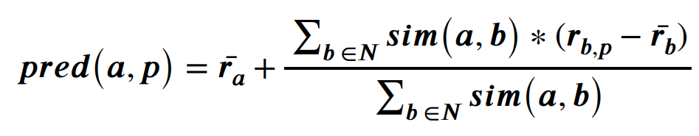
Algorithm
For a user with some items without ratings
Find 50 most similar users by traversing the content matrix
Pearson correlation
Calculate rating for a missing rating
Prediction function
Repeat for each item without rating
Recommend top 5 items

Slide 8
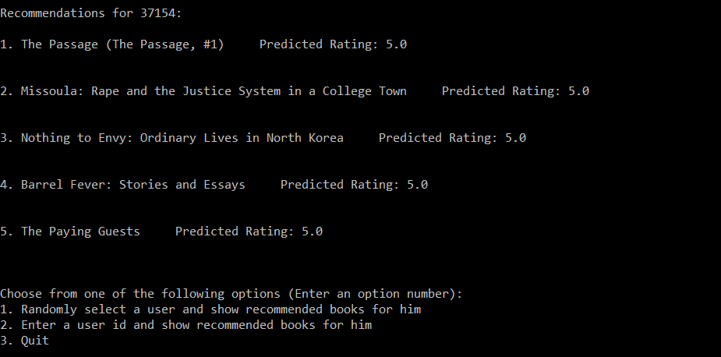
Output

Slide 9
Questions????

